Slide 1




1
Notes:
January 18
1
1

Slide 2



I Know!
I Can!
I Fit!
I can read music.
I know the theory very well.
I understand music compositions.
Will I be able to play in an orchestra
touring the world year in and year
out? You need specific habits to do
this successfully.
I can play the piano on
a professional level.
I have the skill to practice
as a general practitioner.
Can I work as a doctor on an oil
rig for ten years? You need specific
habits to do this successfully.
I am a qualified medical
doctor.
I can answer a phone and help
a client sort out an email
problem, set-up his new Iphone and handle account queries.
Can I do this eight hours a day five
days a week year in year out? You
need specific habits to do this
successfully.
I have matric.

Slide 3


I Can!
=
+
I Know!
Qualifications and
Technical Training / Knowledge
Success
(KPI’s Delivered!)
I Fit!

Slide 4
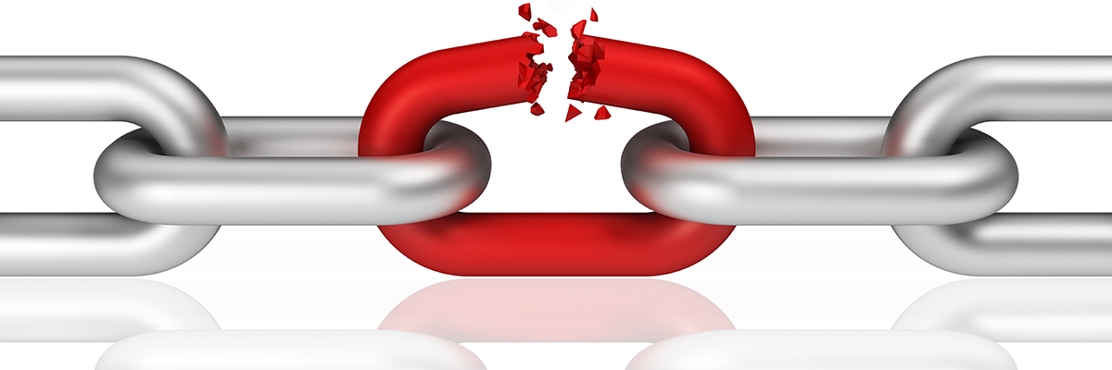
I Can!
=
+
I Know!
Qualifications and
Technical Training /
Knowledge
Performance Failure!
I Fit!

Slide 5


Fit to the environment – I Fit!
An individual can be very successful in one job but fail dismally in
the next. Why?
Can we predict an individuals propensity towards becoming successful in a job?

Slide 6
Fit to the environment – I Fit!
PERSON
Successfully
MATCHED
TASK
CONTEXT
If the environment doesn’t allow the habits (Or absence thereof) of the individual to be functional towards success, that individual has a high propensity to fail.
We need a behavioural context match.

Slide 7
Fit to the environment – I Fit!
PERSON
Successfully
MATCHED
TASK
CONTEXT
HOW?
Top performer benchmark

Slide 8
Fit to the environment – I Fit!
An internet based tool that measures habits.
What is a habit?
It is a behaviour that repeats with
minimal or no conscious planning.
Shadowmatch is a worksheet that looks for the existence of a habit (behavioural patterns) through the completion of tasks.
Shadowmatch fits into the category of simulations,
in-basket exercises, worksheets and so on.
No right/wrong, good/bad, competent/incompetent. We merely measure behaviour patterns.

Slide 9

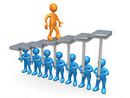


Optimal Placements
Place people to thrive and reach
their goals.
Benchmark Based
Behavioural
New Recruits
Current Employees
Succession
Restructuring
Leaders to Teams
Mergers & Acquisitions
Employee Support
Employee Development Programs
for optimal workplace success.
Personal Development Programs
Personal Full Report
Performance Counselling
Team Role Clarification
Structured Coaching
3. Winning Teams
Build and develop winning
teams.
Team Behaviour Analysis
Team Role & Group Analysis
Team Reports
Team Building Activities
4. Personal Fulfilment
Personal fulfilment and
growth.
Personal Reports
Career Counselling
Relationship Success
Triumph over Trauma
Stress Management
Functions & Reports:
Benchmarks
Interview Packs
Recruitment Spec
Matching Report
Mutimatching
Functions & Reports:
PDP’s
Full Reports
Team Report
Team Analysis
Functions & Reports:
Team Analysis
Team Behavior Graphs
Team Role Groupings
Team Reports
Team Building Programs
Functions & Reports:
Full Reports
Intro Report
Short Report
Team Report
Relationship Reports

Slide 10
Skills measured:
Administrative Skills
Business Process Design Skills
Coaching and Mentoring Skills
Design and Artistic Skills (1)
Facilitation Skills
Financial Management Skills
Computer Literacy Skills (11)
IT Programming Skills (31)
Management Skills (5)
Mathematical and Numerical Skills
Negotiation Skills
People Skills / Customer Service Skills
Physical Skills
Planning Skills
Presentation Skills
Project Management Skills (18)
Selling Skills
Social Media Skills (8)
Technical Skills (1)
Training / Teaching / Lecturing Skills
Verbal Skills (31)
Writing Skills (31)
Machine Operating Skills (1)
Caregiving Skills (6)
Musical Skills (15)

Slide 11
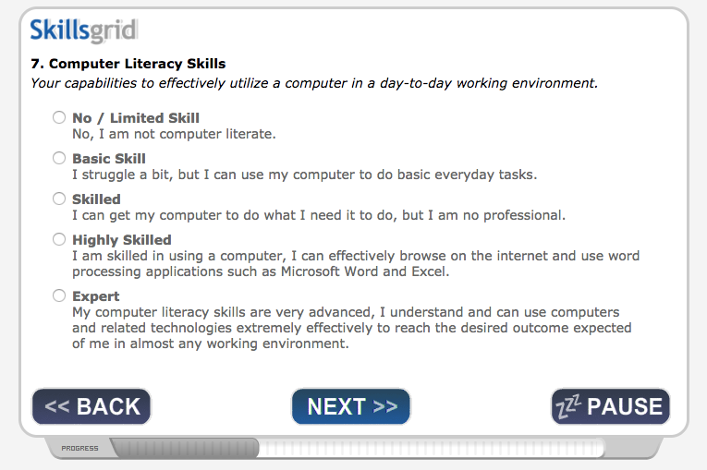

Slide 12
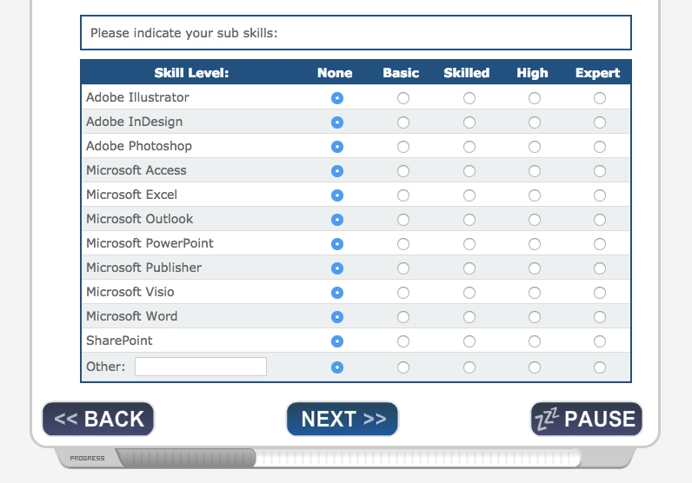

Slide 13
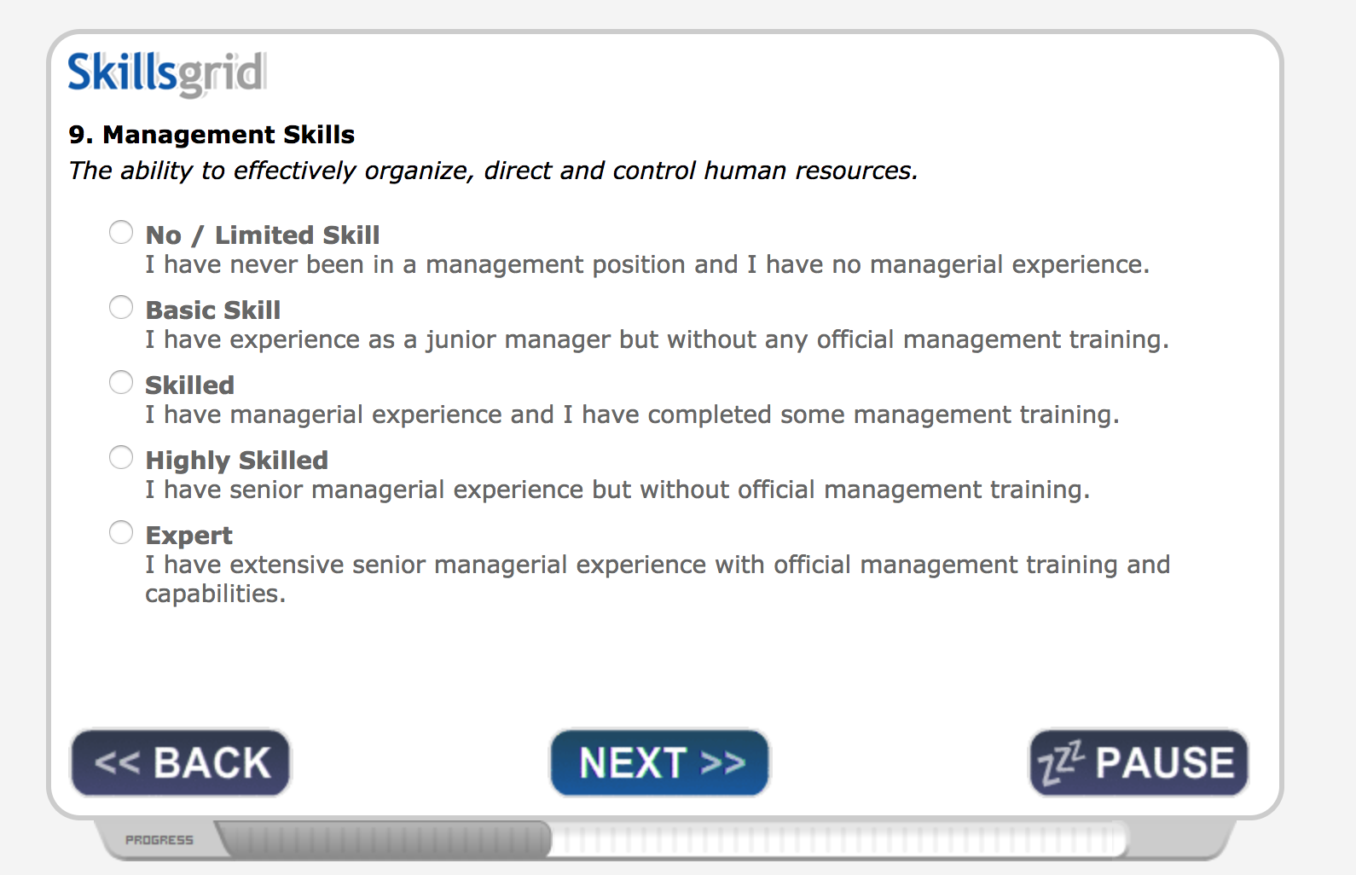

Slide 14
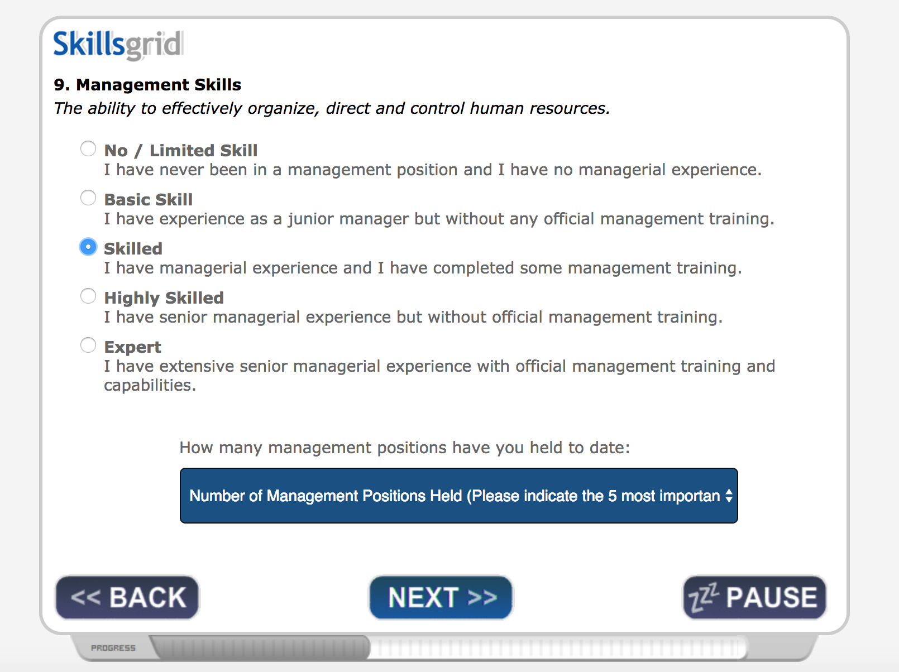

Slide 15
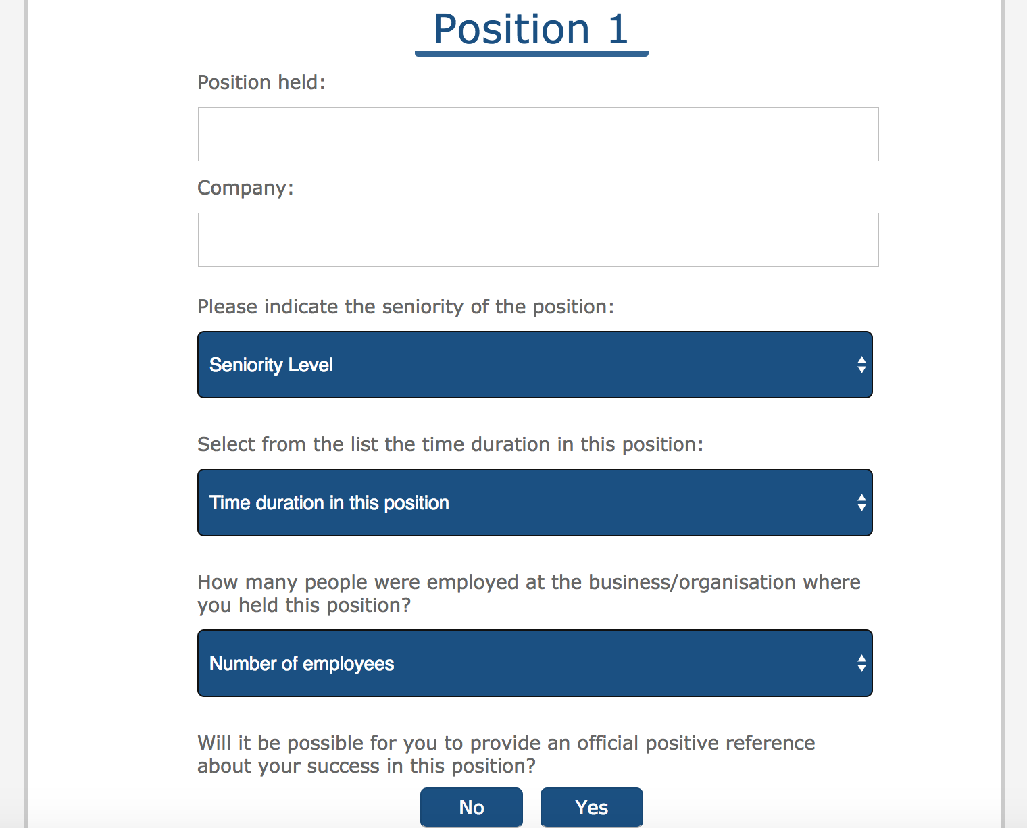

Slide 16
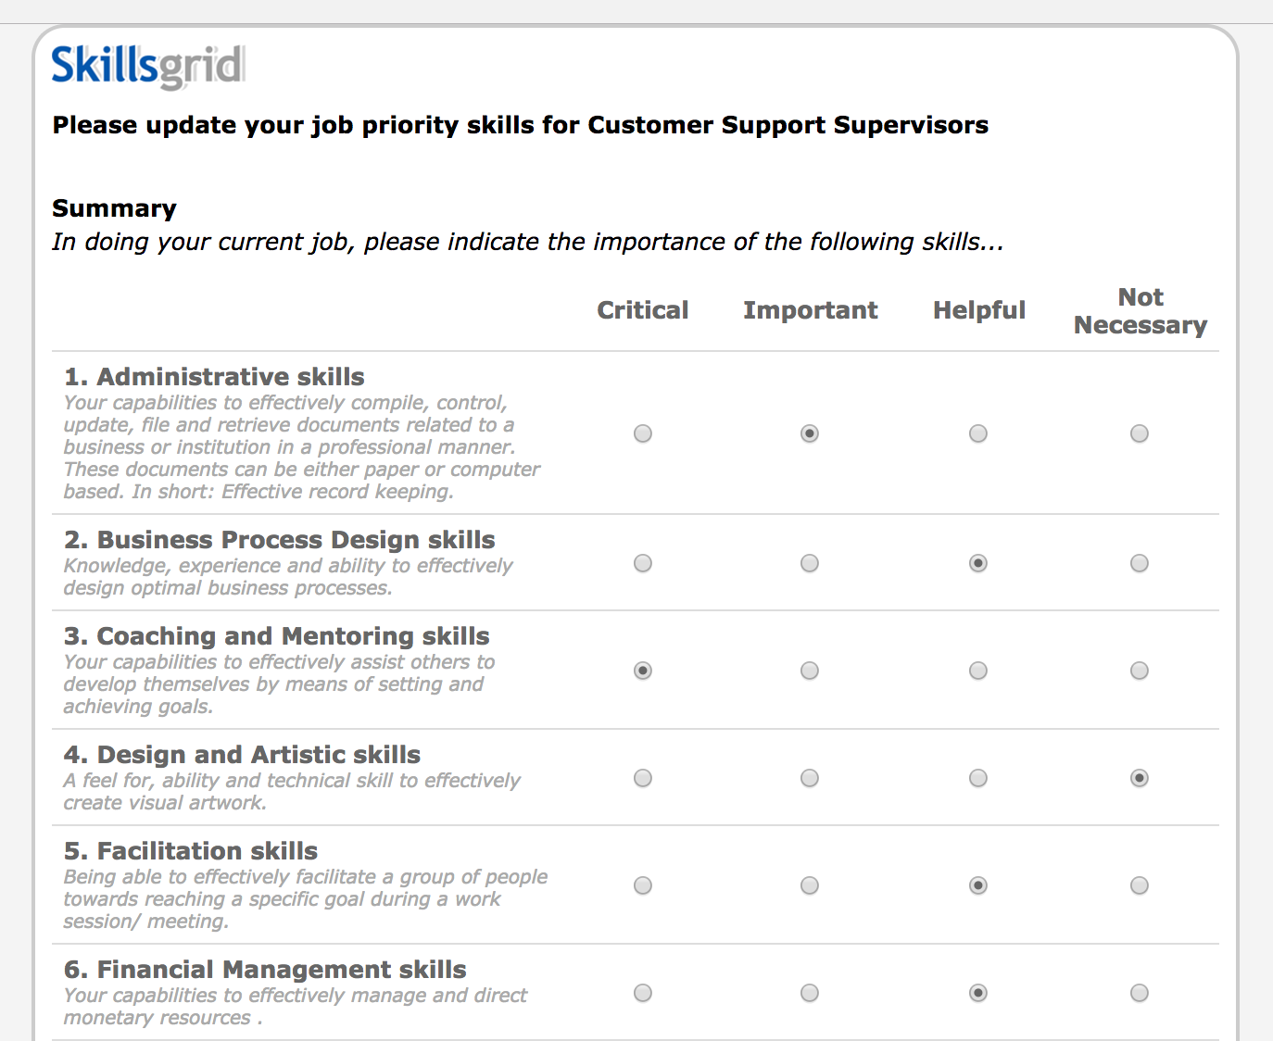

Slide 17
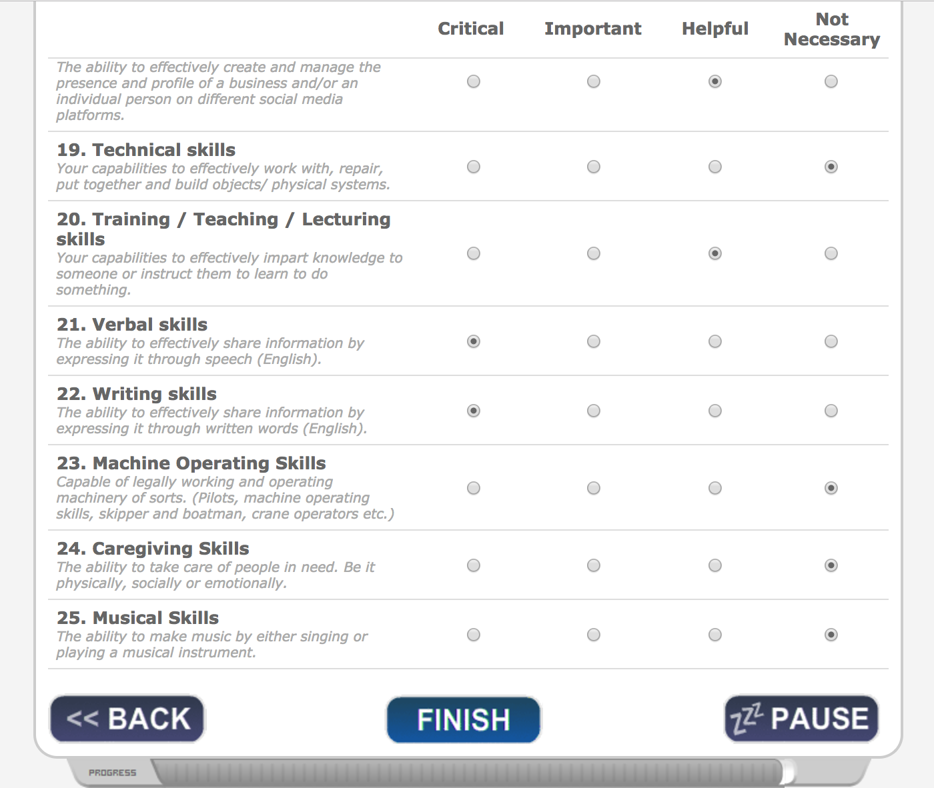
Benchmark example

